Slide 1


Economic Update
    MARKUS KUGER
    Chief Economist
    Dun & Bradstreet
Notes:
Thank you, Louise
It will be my job to talk you through the macroeconomic consequences of the coronavirus pandemic and unfortunately, the next 5 minutes will be like a horror story as the impact is very severe.
*next slide*

Slide 2
Agenda
The latest economic data
  Stock markets
  Exchange rates
  Commodity prices
  Labour market
  Inflation
  GDP
Impact on country risk levels
What’s next?
Q&A
Notes:
Together with never seen before monetary easing, this fiscal stimulus has helped to calm stock market investors in April but compared with pre-crisis level, stock market indices remain deeply in the red across the globe. Despite the recovery seen in April, the FTSE 100 in the UK is still almost 29% down against its reading in late January. In the US, the Standard & Poor 500 Stock Price Index stands 23% below its January value.
The covid outbreak and the implementation of lockdown measures around the globe has also led to never seen before volatility on stock markets. Although some of the uncertainty has eased over the past weeks, investors are still anxious about the outlook. A persistent upturn will rely on the successful removal of lockdown measures and the return to normality, a process that might not be as straight forward as initially anticipated.
*next slide*

Slide 3
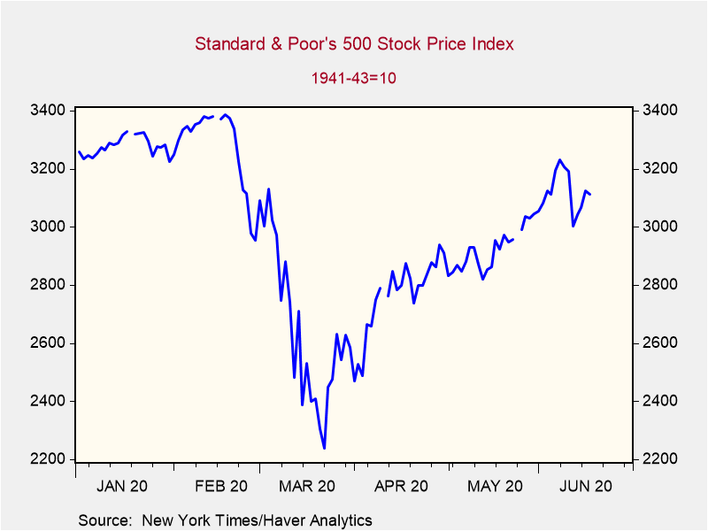
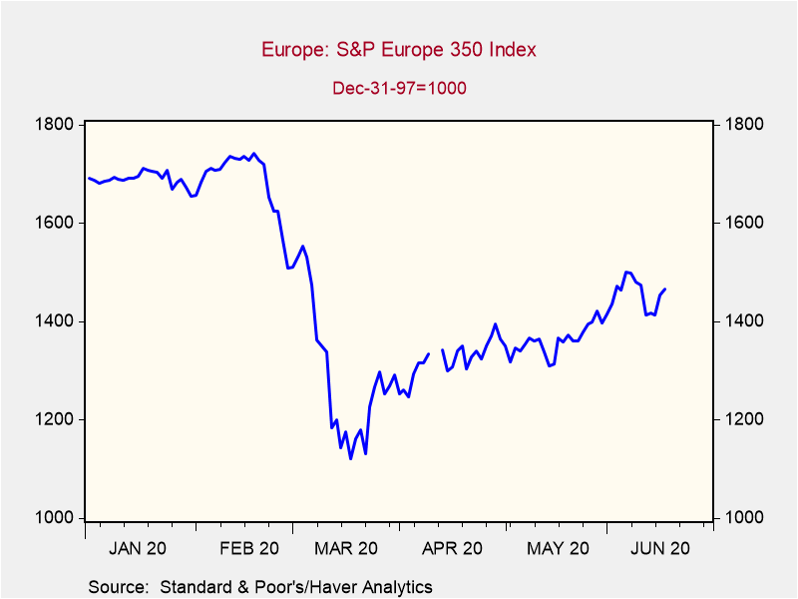
stock markets collapsed in March but have since then bounced back
Notes:
Together with never seen before monetary easing, this fiscal stimulus has helped to calm stock market investors in April but compared with pre-crisis level, stock market indices remain deeply in the red across the globe. Despite the recovery seen in April, the FTSE 100 in the UK is still almost 29% down against its reading in late January. In the US, the Standard & Poor 500 Stock Price Index stands 23% below its January value.
The covid outbreak and the implementation of lockdown measures around the globe has also led to never seen before volatility on stock markets. Although some of the uncertainty has eased over the past weeks, investors are still anxious about the outlook. A persistent upturn will rely on the successful removal of lockdown measures and the return to normality, a process that might not be as straight forward as initially anticipated.
*next slide*

Slide 4
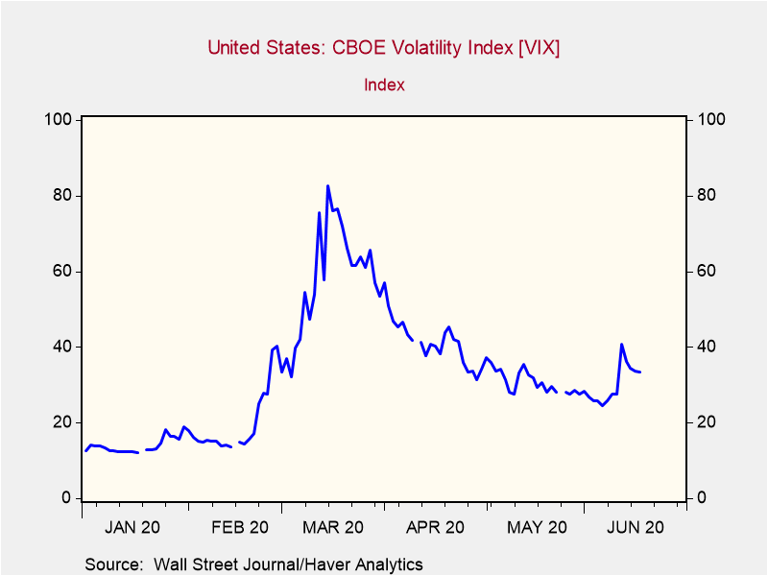
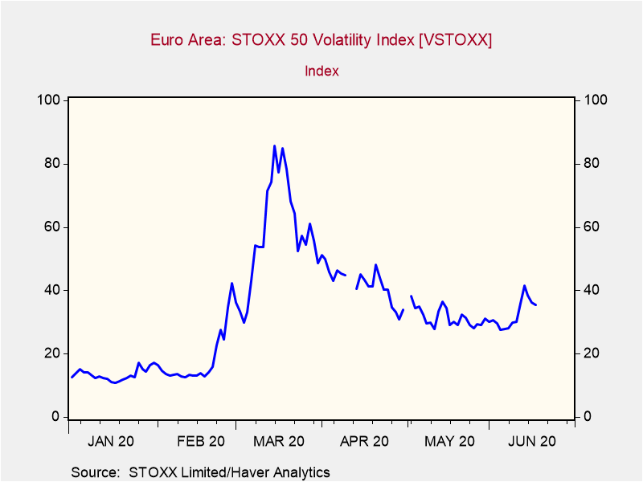
Stock Market Volatility has picked up again
Notes:
Together with never seen before monetary easing, this fiscal stimulus has helped to calm stock market investors in April but compared with pre-crisis level, stock market indices remain deeply in the red across the globe. Despite the recovery seen in April, the FTSE 100 in the UK is still almost 29% down against its reading in late January. In the US, the Standard & Poor 500 Stock Price Index stands 23% below its January value.
The covid outbreak and the implementation of lockdown measures around the globe has also led to never seen before volatility on stock markets. Although some of the uncertainty has eased over the past weeks, investors are still anxious about the outlook. A persistent upturn will rely on the successful removal of lockdown measures and the return to normality, a process that might not be as straight forward as initially anticipated.
*next slide*

Slide 5
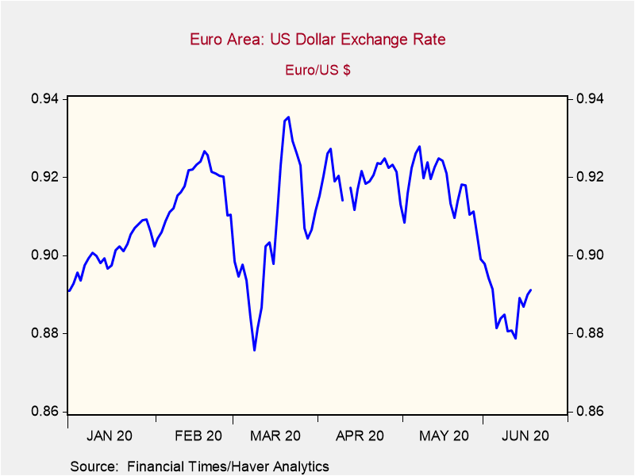
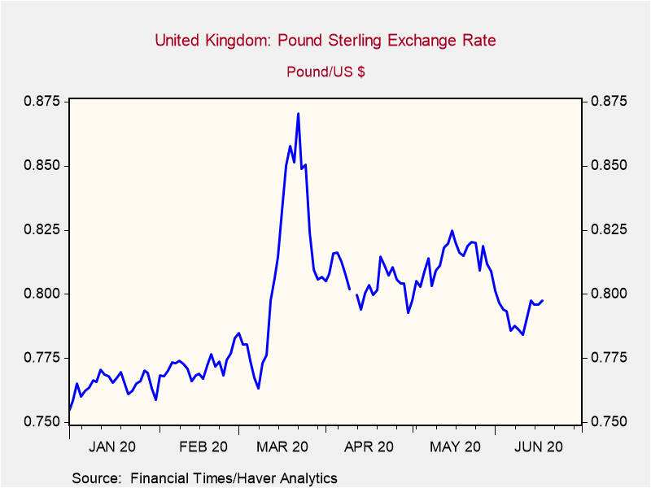
Modest Movements between USD,GBP and EUR since pandemic outbreak
Notes:
Together with never seen before monetary easing, this fiscal stimulus has helped to calm stock market investors in April but compared with pre-crisis level, stock market indices remain deeply in the red across the globe. Despite the recovery seen in April, the FTSE 100 in the UK is still almost 29% down against its reading in late January. In the US, the Standard & Poor 500 Stock Price Index stands 23% below its January value.
The covid outbreak and the implementation of lockdown measures around the globe has also led to never seen before volatility on stock markets. Although some of the uncertainty has eased over the past weeks, investors are still anxious about the outlook. A persistent upturn will rely on the successful removal of lockdown measures and the return to normality, a process that might not be as straight forward as initially anticipated.
*next slide*

Slide 6
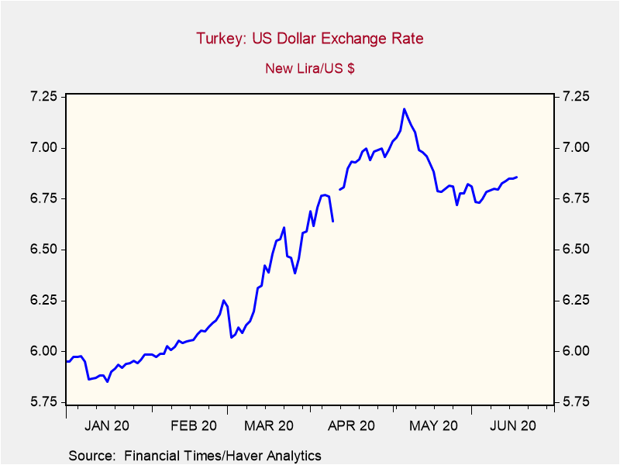
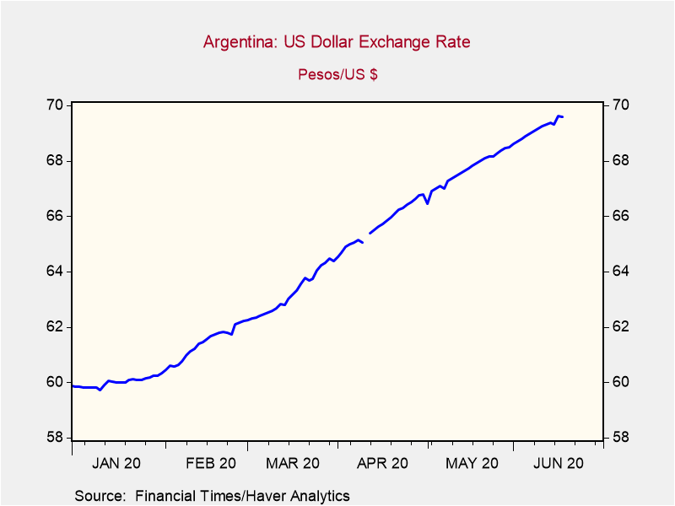
Emerging Market Currencies have depreciated significantly
Notes:
Together with never seen before monetary easing, this fiscal stimulus has helped to calm stock market investors in April but compared with pre-crisis level, stock market indices remain deeply in the red across the globe. Despite the recovery seen in April, the FTSE 100 in the UK is still almost 29% down against its reading in late January. In the US, the Standard & Poor 500 Stock Price Index stands 23% below its January value.
The covid outbreak and the implementation of lockdown measures around the globe has also led to never seen before volatility on stock markets. Although some of the uncertainty has eased over the past weeks, investors are still anxious about the outlook. A persistent upturn will rely on the successful removal of lockdown measures and the return to normality, a process that might not be as straight forward as initially anticipated.
*next slide*

Slide 7
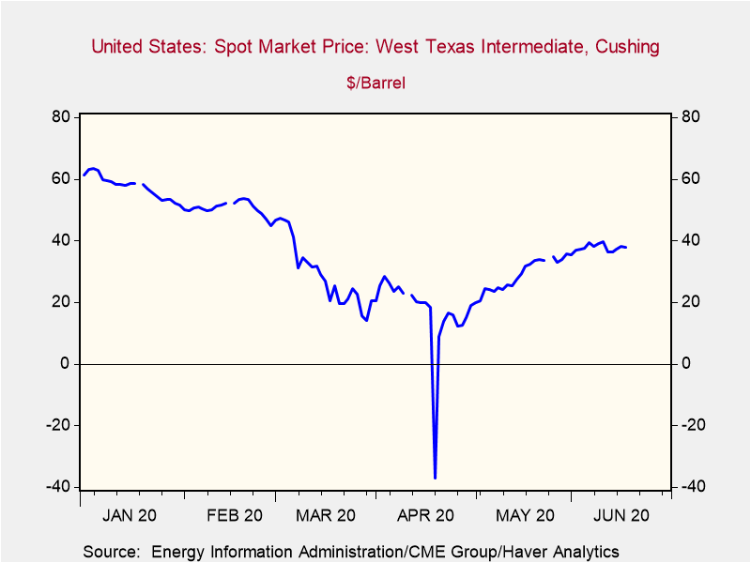
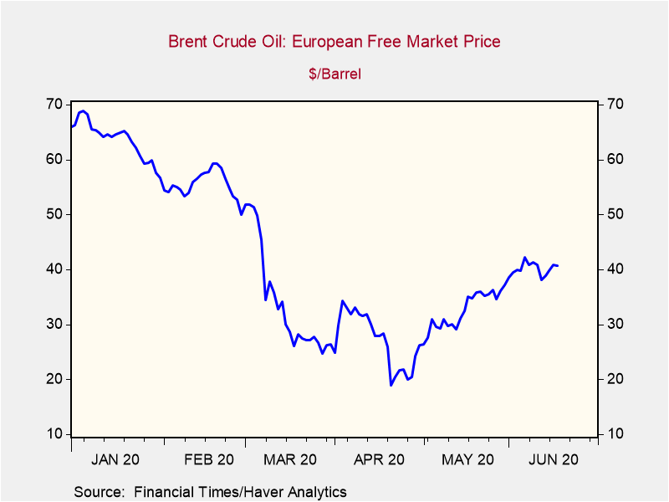
Commodity prices are below January-readings…
Notes:
Together with never seen before monetary easing, this fiscal stimulus has helped to calm stock market investors in April but compared with pre-crisis level, stock market indices remain deeply in the red across the globe. Despite the recovery seen in April, the FTSE 100 in the UK is still almost 29% down against its reading in late January. In the US, the Standard & Poor 500 Stock Price Index stands 23% below its January value.
The covid outbreak and the implementation of lockdown measures around the globe has also led to never seen before volatility on stock markets. Although some of the uncertainty has eased over the past weeks, investors are still anxious about the outlook. A persistent upturn will rely on the successful removal of lockdown measures and the return to normality, a process that might not be as straight forward as initially anticipated.
*next slide*

Slide 8
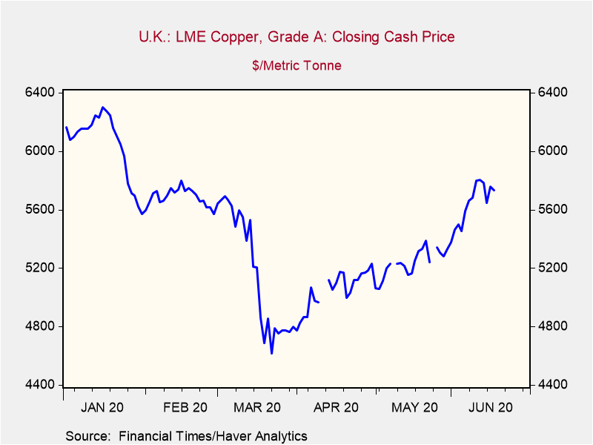
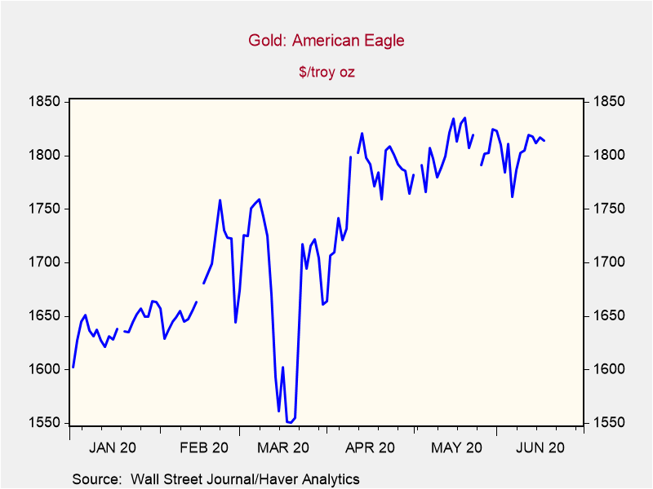
…with the exception of gold
Notes:
Together with never seen before monetary easing, this fiscal stimulus has helped to calm stock market investors in April but compared with pre-crisis level, stock market indices remain deeply in the red across the globe. Despite the recovery seen in April, the FTSE 100 in the UK is still almost 29% down against its reading in late January. In the US, the Standard & Poor 500 Stock Price Index stands 23% below its January value.
The covid outbreak and the implementation of lockdown measures around the globe has also led to never seen before volatility on stock markets. Although some of the uncertainty has eased over the past weeks, investors are still anxious about the outlook. A persistent upturn will rely on the successful removal of lockdown measures and the return to normality, a process that might not be as straight forward as initially anticipated.
*next slide*

Slide 9
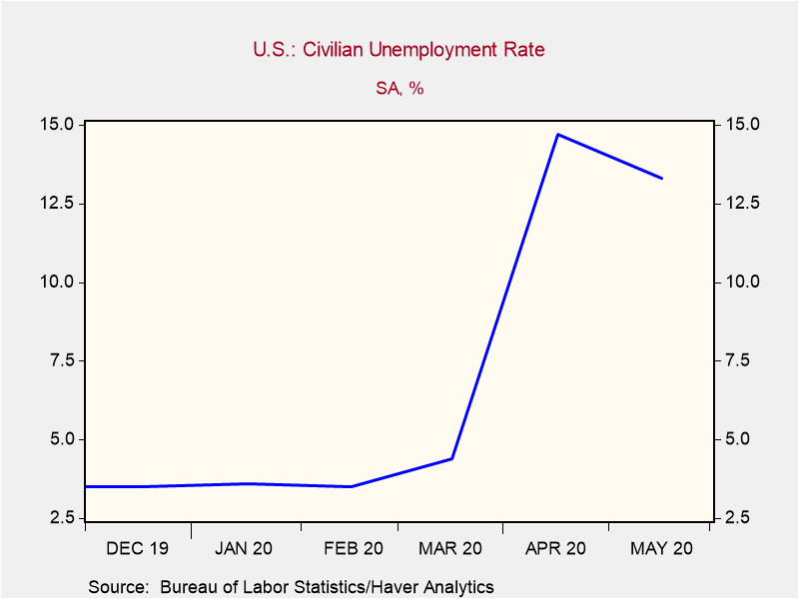
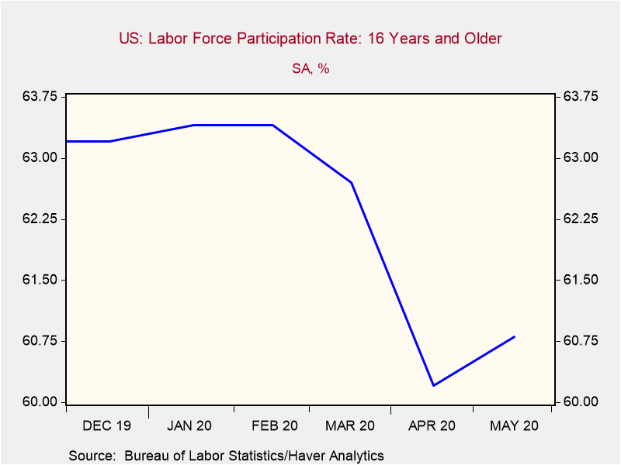
The US Labour Market deteriorated quickly
Notes:
Together with never seen before monetary easing, this fiscal stimulus has helped to calm stock market investors in April but compared with pre-crisis level, stock market indices remain deeply in the red across the globe. Despite the recovery seen in April, the FTSE 100 in the UK is still almost 29% down against its reading in late January. In the US, the Standard & Poor 500 Stock Price Index stands 23% below its January value.
The covid outbreak and the implementation of lockdown measures around the globe has also led to never seen before volatility on stock markets. Although some of the uncertainty has eased over the past weeks, investors are still anxious about the outlook. A persistent upturn will rely on the successful removal of lockdown measures and the return to normality, a process that might not be as straight forward as initially anticipated.
*next slide*

Slide 10
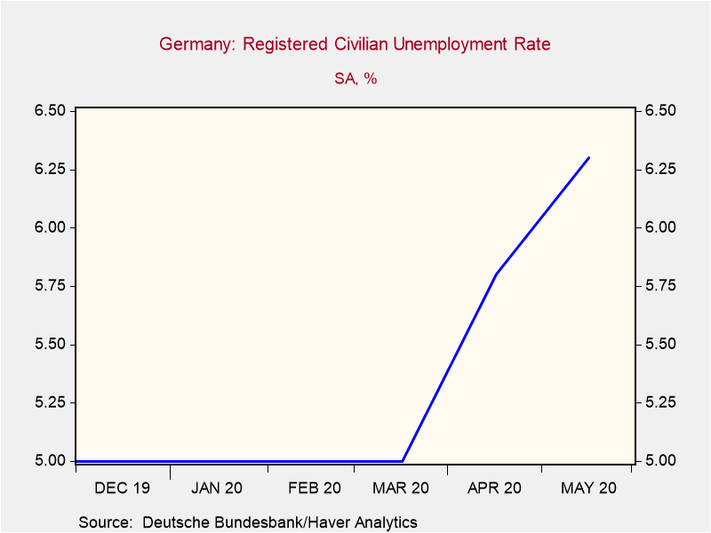
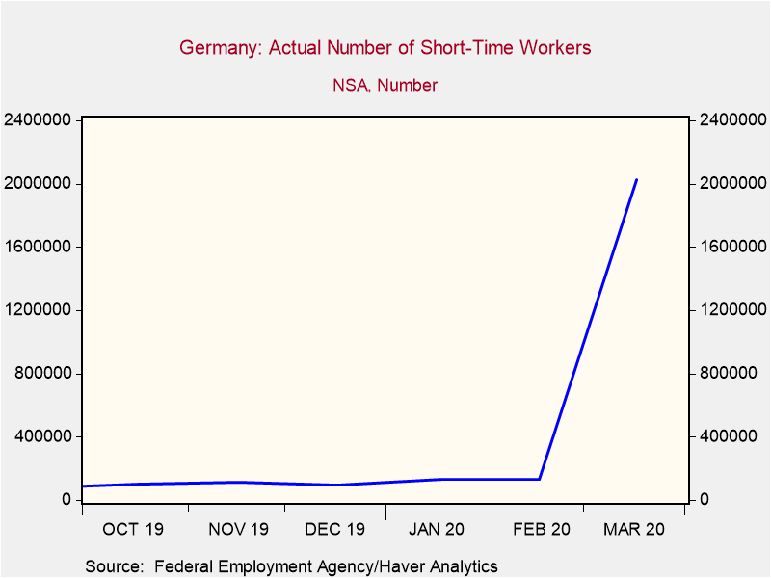
Unemployment in Europe remains low but only because of Government schemes
Notes:
Together with never seen before monetary easing, this fiscal stimulus has helped to calm stock market investors in April but compared with pre-crisis level, stock market indices remain deeply in the red across the globe. Despite the recovery seen in April, the FTSE 100 in the UK is still almost 29% down against its reading in late January. In the US, the Standard & Poor 500 Stock Price Index stands 23% below its January value.
The covid outbreak and the implementation of lockdown measures around the globe has also led to never seen before volatility on stock markets. Although some of the uncertainty has eased over the past weeks, investors are still anxious about the outlook. A persistent upturn will rely on the successful removal of lockdown measures and the return to normality, a process that might not be as straight forward as initially anticipated.
*next slide*

Slide 11
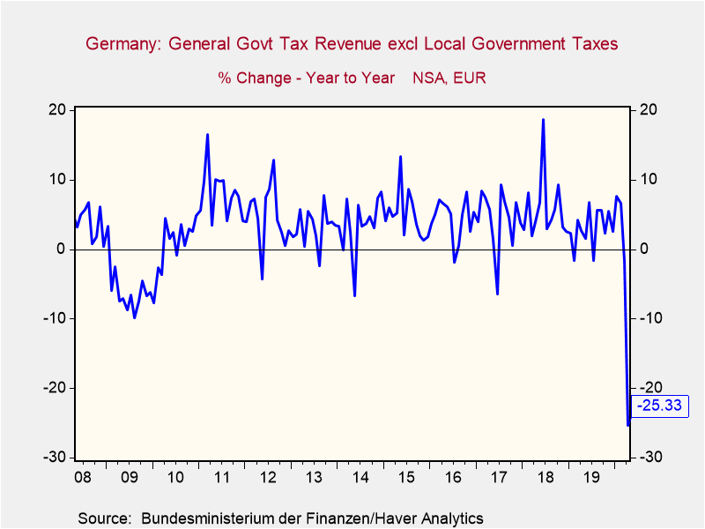
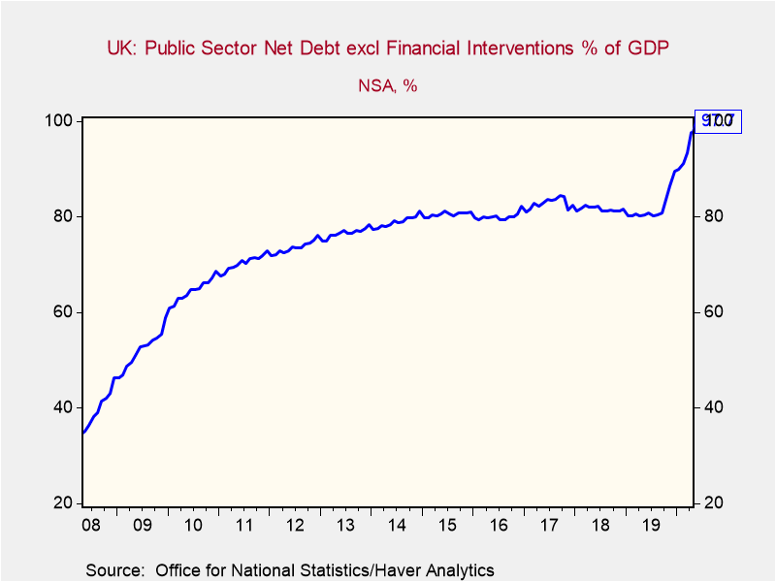
Government Finances are Deteriorating Rapidly
Notes:
Together with never seen before monetary easing, this fiscal stimulus has helped to calm stock market investors in April but compared with pre-crisis level, stock market indices remain deeply in the red across the globe. Despite the recovery seen in April, the FTSE 100 in the UK is still almost 29% down against its reading in late January. In the US, the Standard & Poor 500 Stock Price Index stands 23% below its January value.
The covid outbreak and the implementation of lockdown measures around the globe has also led to never seen before volatility on stock markets. Although some of the uncertainty has eased over the past weeks, investors are still anxious about the outlook. A persistent upturn will rely on the successful removal of lockdown measures and the return to normality, a process that might not be as straight forward as initially anticipated.
*next slide*

Slide 12
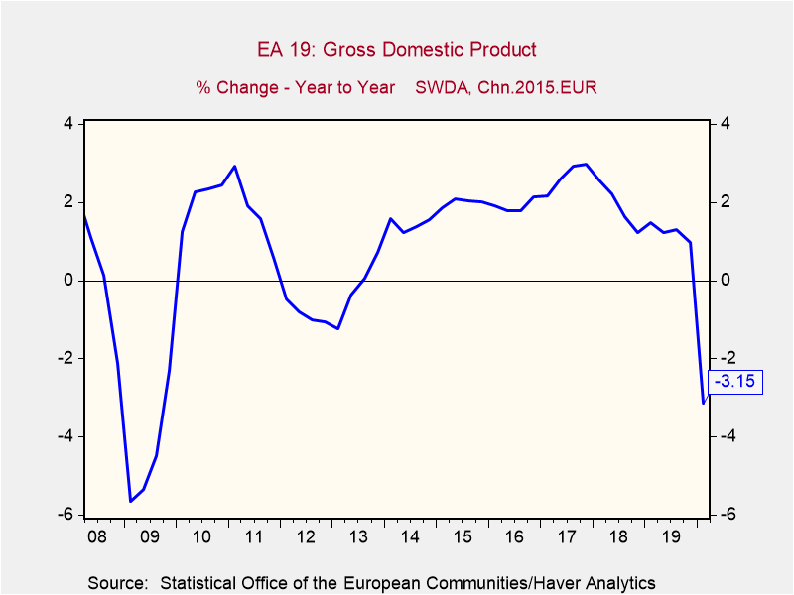
Eurozone Real GDP Dropped by 3.2% y/y in Q1 2020
Notes:
Together with never seen before monetary easing, this fiscal stimulus has helped to calm stock market investors in April but compared with pre-crisis level, stock market indices remain deeply in the red across the globe. Despite the recovery seen in April, the FTSE 100 in the UK is still almost 29% down against its reading in late January. In the US, the Standard & Poor 500 Stock Price Index stands 23% below its January value.
The covid outbreak and the implementation of lockdown measures around the globe has also led to never seen before volatility on stock markets. Although some of the uncertainty has eased over the past weeks, investors are still anxious about the outlook. A persistent upturn will rely on the successful removal of lockdown measures and the return to normality, a process that might not be as straight forward as initially anticipated.
*next slide*

Slide 13
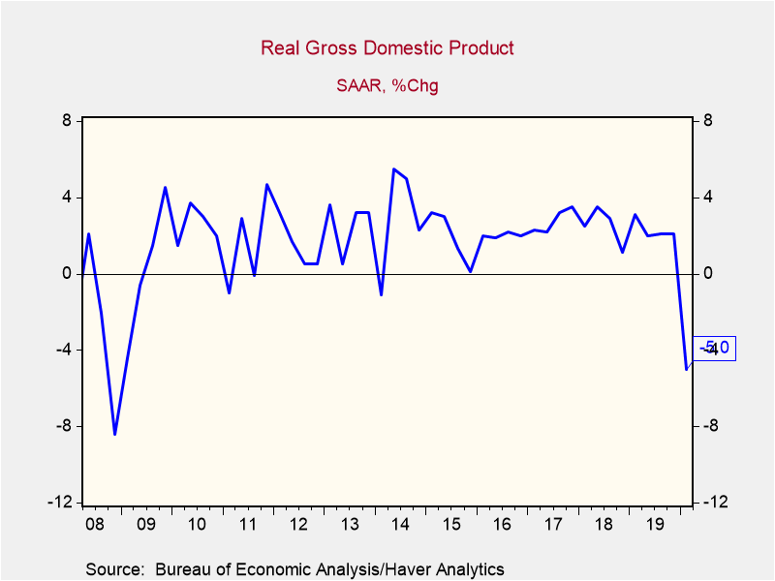
In the US, real GDP contracted by 5.0% y/y in Q1 2020
Notes:
Together with never seen before monetary easing, this fiscal stimulus has helped to calm stock market investors in April but compared with pre-crisis level, stock market indices remain deeply in the red across the globe. Despite the recovery seen in April, the FTSE 100 in the UK is still almost 29% down against its reading in late January. In the US, the Standard & Poor 500 Stock Price Index stands 23% below its January value.
The covid outbreak and the implementation of lockdown measures around the globe has also led to never seen before volatility on stock markets. Although some of the uncertainty has eased over the past weeks, investors are still anxious about the outlook. A persistent upturn will rely on the successful removal of lockdown measures and the return to normality, a process that might not be as straight forward as initially anticipated.
*next slide*

Slide 14
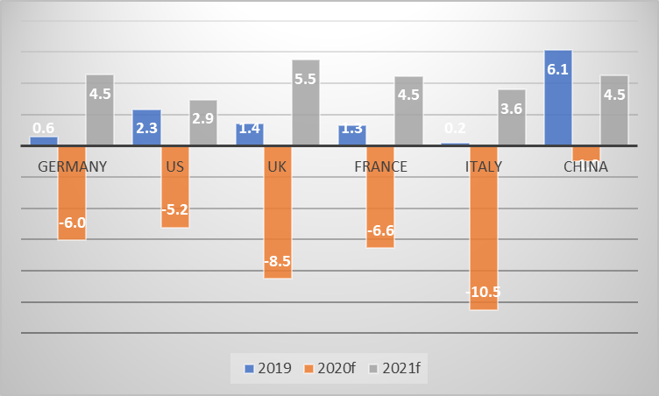
Real GDP Growth Performance
(Dun & Bradstreet Forecasts in %)
Notes:
Together with never seen before monetary easing, this fiscal stimulus has helped to calm stock market investors in April but compared with pre-crisis level, stock market indices remain deeply in the red across the globe. Despite the recovery seen in April, the FTSE 100 in the UK is still almost 29% down against its reading in late January. In the US, the Standard & Poor 500 Stock Price Index stands 23% below its January value.
The covid outbreak and the implementation of lockdown measures around the globe has also led to never seen before volatility on stock markets. Although some of the uncertainty has eased over the past weeks, investors are still anxious about the outlook. A persistent upturn will rely on the successful removal of lockdown measures and the return to normality, a process that might not be as straight forward as initially anticipated.
*next slide*

Slide 15
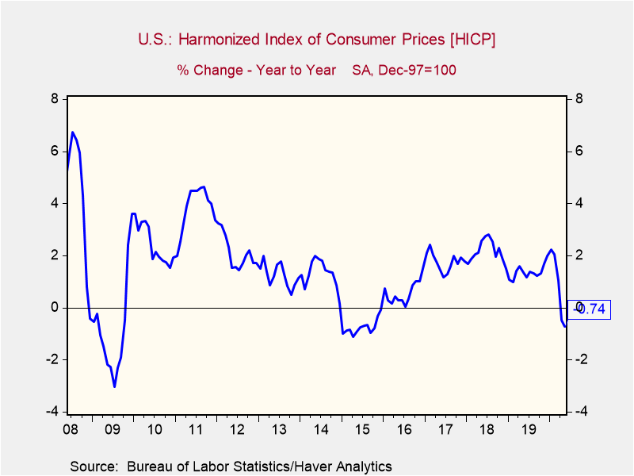
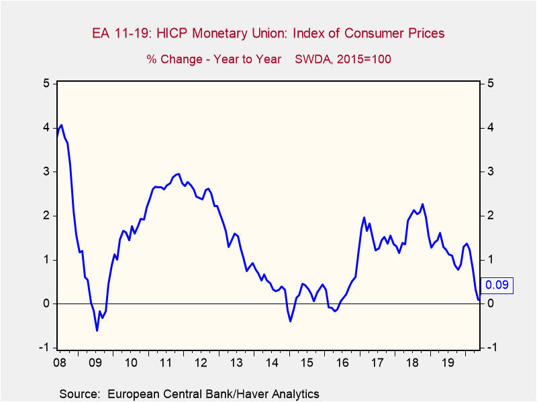
Inflation rates are coming down
Notes:
Together with never seen before monetary easing, this fiscal stimulus has helped to calm stock market investors in April but compared with pre-crisis level, stock market indices remain deeply in the red across the globe. Despite the recovery seen in April, the FTSE 100 in the UK is still almost 29% down against its reading in late January. In the US, the Standard & Poor 500 Stock Price Index stands 23% below its January value.
The covid outbreak and the implementation of lockdown measures around the globe has also led to never seen before volatility on stock markets. Although some of the uncertainty has eased over the past weeks, investors are still anxious about the outlook. A persistent upturn will rely on the successful removal of lockdown measures and the return to normality, a process that might not be as straight forward as initially anticipated.
*next slide*

Slide 16
The fiscal response is immense…
… BUT IT VARIES FROM COUNTRY TO COUNTRY
Notes:
Positively, governments have reacted to the virus outbreak and have launched significant fiscal support packages that are bigger than the ones introduced in the financial crisis in 2008-09. Latest data from the International Monetary Fund shows that, to date, the G20 economies have increased spending by 3.5% of GDP. In 2008, this figure stood at a meagre 0.5% and even in 2009 at the height of the financial crisis, this metrics did not exceed 2.1% of G20-GDP
That said, the magnitude of the response varies from country to country as governments have launched a plethora of direct and indirect measures to stimulate the ailing economy. In South Africa, which is bottom of the league, the government has so far increased spending by 0.6% of GDP while in the UK, revenue and expenditure measures stood at 3.1% of GDP and so called below the line measures, such as credit guarantees stand at a high 15.7%. Both measures combined sum up to almost a fifth of domestic GDP. This only topped by Japan, Italy and Germany. The latter has increased spending by 4.4% of GDP and the government is guaranteeing loans worth almost 30% of national GDP
*next slide*

Slide 17
Dun & Bradstreet’s Country risk model
D&B Country Risk
D&B Country Risk:
A comparative cross-border assessment of risk and opportunity:
DATA AND SOURCES
POLITICAL/ INSECURITY RISK
EXPROPRIATION/ NATIONALISATION RISK
Quantitative data (GDP, inflation, interest rates, exchange rates, government sector accounts, debt, leading indicators, trade, incidence of natural disasters etc)
Qualitative data (Doing Business rankings, Global Competitiveness Report rankings, corruption rankings, expropriation and nationalisation history, infrastructure, property rights, human capital, trade deals, taxation etc)
Real-Time Intelligence This is incorporated on ad hoc basis to ensure alignment of risk model with critical events.
>100 variables sourced from D&B company data and external sources (World Bank; IMF; Freedom House; Transparency International; WEF; etc)
8
9
TRANSFER RISK
BUSINESS REGULATORY ENVIRONMENT
BUSINESS CONTINUITY RISK
5
6
7
SHORT-TERM ECONOMIC RISK
LONG-TERM ECONOMIC POTENTIAL
MARKET POTENTIAL
FX RISK
1
2
3
4

Slide 18

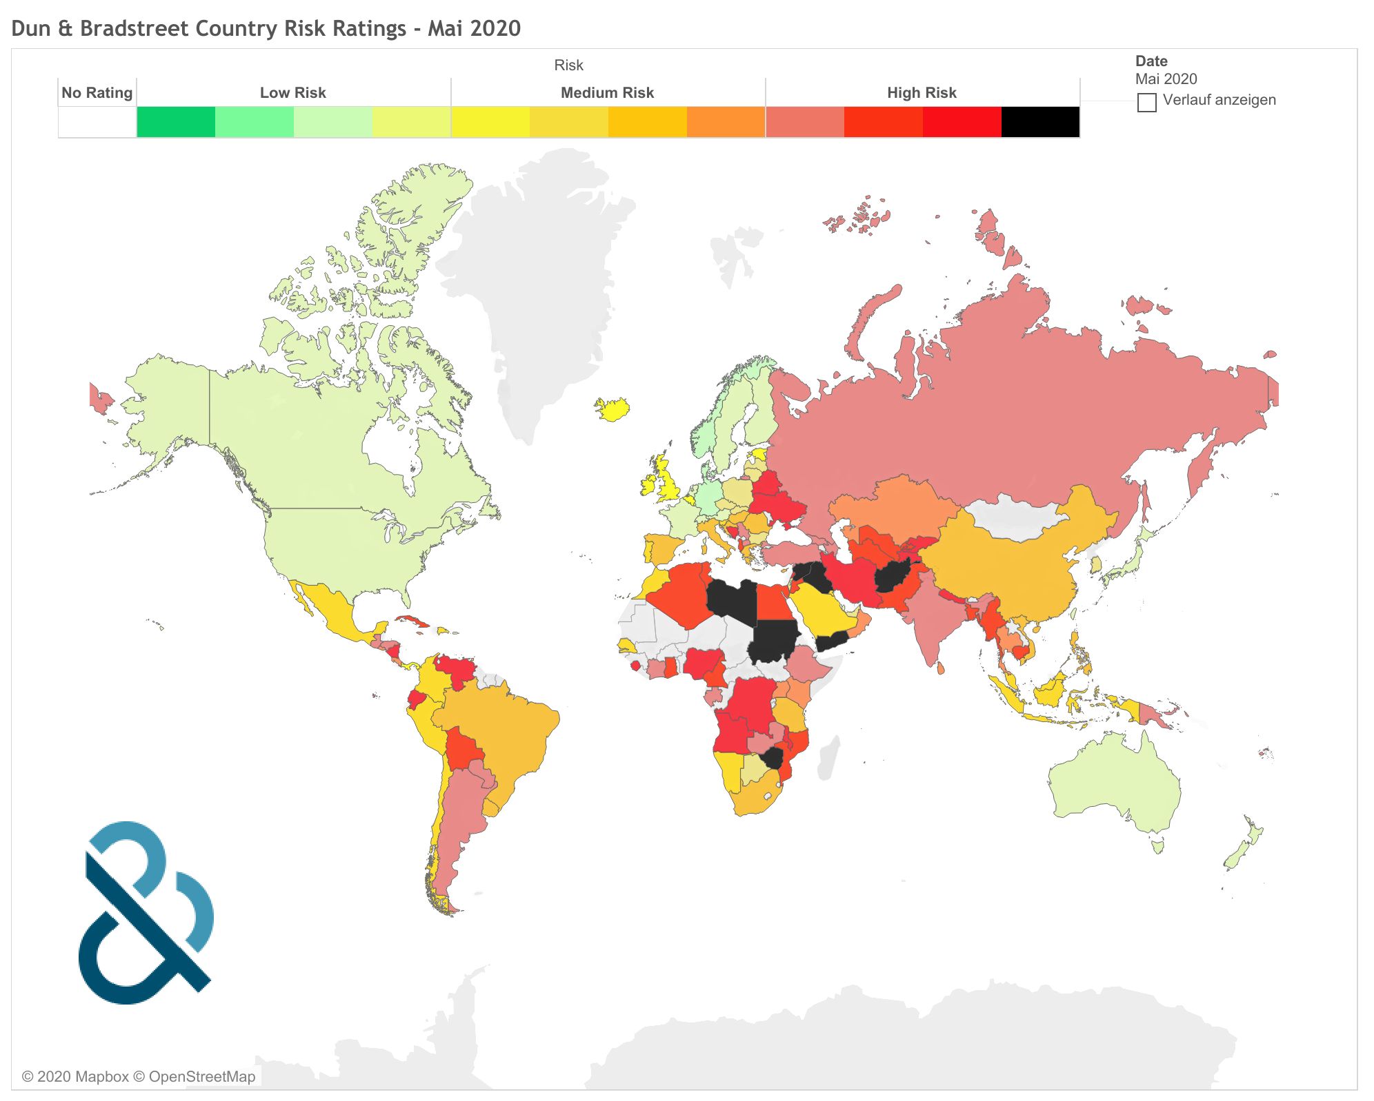
Dun & Bradstreet has downgraded More Than
100 country risk ratings since late January
Notes:
As a consequence of the coronavirus outbreak, Dun & Bradstreet has revised growth projections downwards, lowered inflation forecasts and expects significantly increased unemployment rates around the globe while at the same time, political and supply chain risks will also rise.
As a result, the Country Insight Team has downgraded 70 countries by a total of 110 quartiles since late January. In the same period, no upgrades were carried out. Many of the 132 states the team is covering are now on an all time low, including the UK.
*next slide*

Slide 19
Country Risk Rating Overview
 | Jan-20 | June-20 | Jun-09
Germany | DB1d | DB2b | DB2a
US | DB2a | DB2c | DB2a
France | DB2a | DB2c | DB2a
UK | DB2d | DB3b | DB2b
Italy | DB4a | DB4d | DB3a
China | DB4c | DB4c | DB3d
Notes:
Together with never seen before monetary easing, this fiscal stimulus has helped to calm stock market investors in April but compared with pre-crisis level, stock market indices remain deeply in the red across the globe. Despite the recovery seen in April, the FTSE 100 in the UK is still almost 29% down against its reading in late January. In the US, the Standard & Poor 500 Stock Price Index stands 23% below its January value.
The covid outbreak and the implementation of lockdown measures around the globe has also led to never seen before volatility on stock markets. Although some of the uncertainty has eased over the past weeks, investors are still anxious about the outlook. A persistent upturn will rely on the successful removal of lockdown measures and the return to normality, a process that might not be as straight forward as initially anticipated.
*next slide*

Slide 20
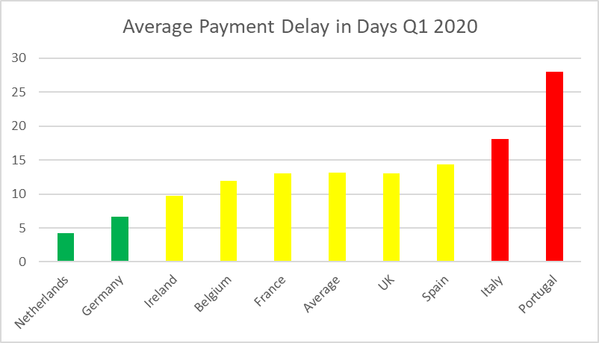
B2b Payments Performance in Europe was Improving before the Pandemic
Notes:
Together with never seen before monetary easing, this fiscal stimulus has helped to calm stock market investors in April but compared with pre-crisis level, stock market indices remain deeply in the red across the globe. Despite the recovery seen in April, the FTSE 100 in the UK is still almost 29% down against its reading in late January. In the US, the Standard & Poor 500 Stock Price Index stands 23% below its January value.
The covid outbreak and the implementation of lockdown measures around the globe has also led to never seen before volatility on stock markets. Although some of the uncertainty has eased over the past weeks, investors are still anxious about the outlook. A persistent upturn will rely on the successful removal of lockdown measures and the return to normality, a process that might not be as straight forward as initially anticipated.
*next slide*

Slide 21
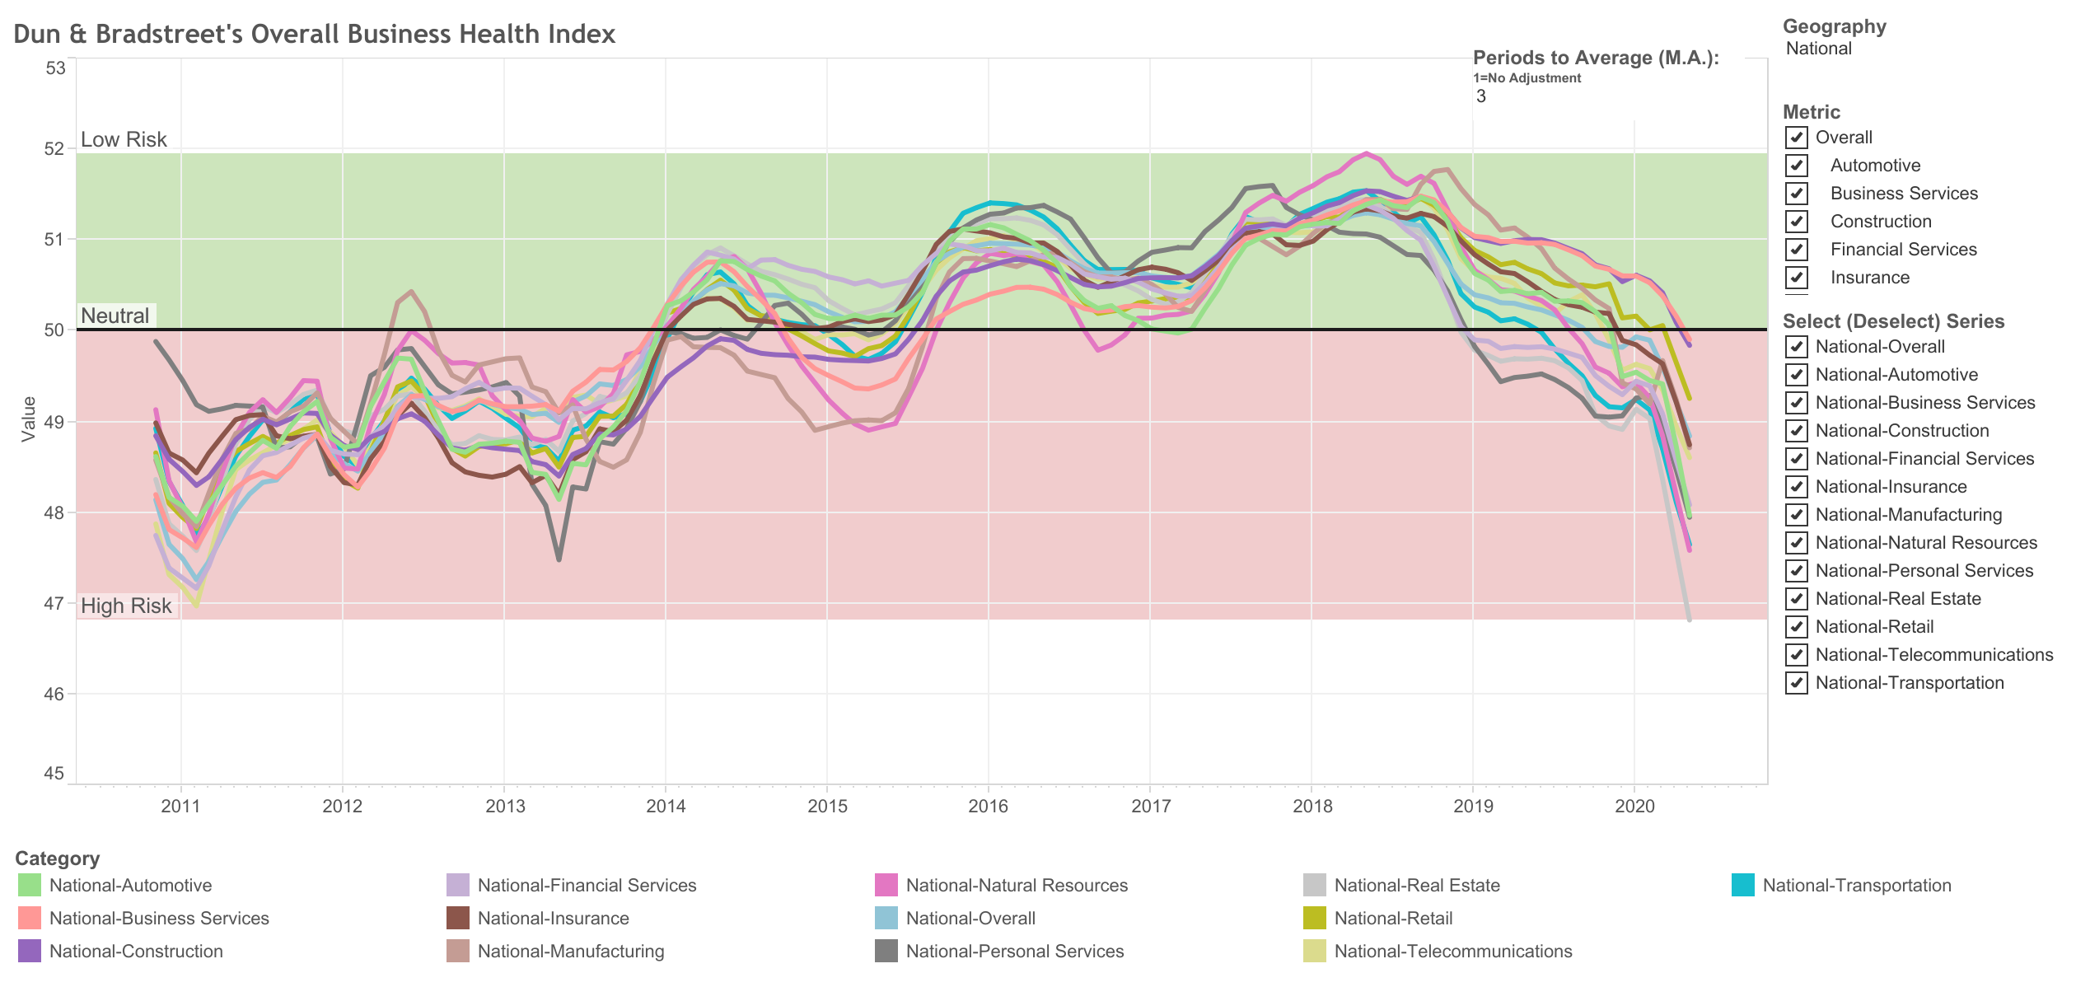
Proprietary Data for the US shows rapid decline in financial health
Source: D&B Overall Business Health Index
Notes:
Together with never seen before monetary easing, this fiscal stimulus has helped to calm stock market investors in April but compared with pre-crisis level, stock market indices remain deeply in the red across the globe. Despite the recovery seen in April, the FTSE 100 in the UK is still almost 29% down against its reading in late January. In the US, the Standard & Poor 500 Stock Price Index stands 23% below its January value.
The covid outbreak and the implementation of lockdown measures around the globe has also led to never seen before volatility on stock markets. Although some of the uncertainty has eased over the past weeks, investors are still anxious about the outlook. A persistent upturn will rely on the successful removal of lockdown measures and the return to normality, a process that might not be as straight forward as initially anticipated.
*next slide*

Slide 22
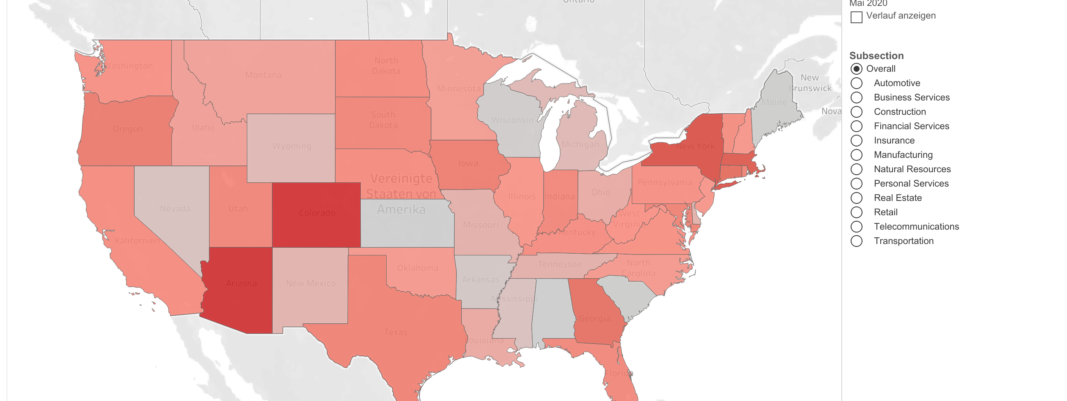
Proprietary Data for the US shows rapid decline in financial health
Notes:
Together with never seen before monetary easing, this fiscal stimulus has helped to calm stock market investors in April but compared with pre-crisis level, stock market indices remain deeply in the red across the globe. Despite the recovery seen in April, the FTSE 100 in the UK is still almost 29% down against its reading in late January. In the US, the Standard & Poor 500 Stock Price Index stands 23% below its January value.
The covid outbreak and the implementation of lockdown measures around the globe has also led to never seen before volatility on stock markets. Although some of the uncertainty has eased over the past weeks, investors are still anxious about the outlook. A persistent upturn will rely on the successful removal of lockdown measures and the return to normality, a process that might not be as straight forward as initially anticipated.
*next slide*

Slide 23




Summary
The pandemic is still impacting on all aspects of economic life and weighs on both, supply and demand
Central banks are providing more monetary stimulus than ever and governments are increasing deficits to levels never seen before
Regardless of the stimulus, the world economy will see the biggest peacetime contraction in almost a century
The risk of late and non-payment will increase substantially over the next months
Notes:
Feb: 14 interest rate cuts
Mar: 71 interest rate cuts
Apr to date: 14 cuts
To sum up: these are unprecedented times. Besides the humanitarian costs, the pandemic is impacting on all different aspects of economic life, ranging from trade to investment and consumption as well as supply chain integrity.
In order to mitigate the adverse impacts, governments have launched never seen before stimulus packages while central banks are embarking on more monetary easing. Since February, 99 central banks have cut interest rates.
However, despite the support measures, global GDP will contract significantly this year. Lockdown measures are lifesaving but prove costly from an economic perspective. The speed and the magnitude of the recovery will largely depend on the progress scientists are making in the fight against the virus. While a gradual return to normality over the next weeks and months seems likely in most states, a re-introduction of the measures at a latter stage cannot be ruled out.
As the macroeconomic impact of the covid19 pandemic will be immense, companies will face higher credit risks in the remainder of 2020 and 2021. Although governments are trying their best to support businesses, politicians are already admitting that not every company will survive. In this light we are expecting a deterioration in B2B payments performance and an increase in the number of business liquidations. Counterparty risk assessment will hence become more important in order to be protected against the Covid19-outfall.
Let me now hand you over to the next presenter, my colleague Chris Laws.

Slide 24
THANK YOU

